Slide 1

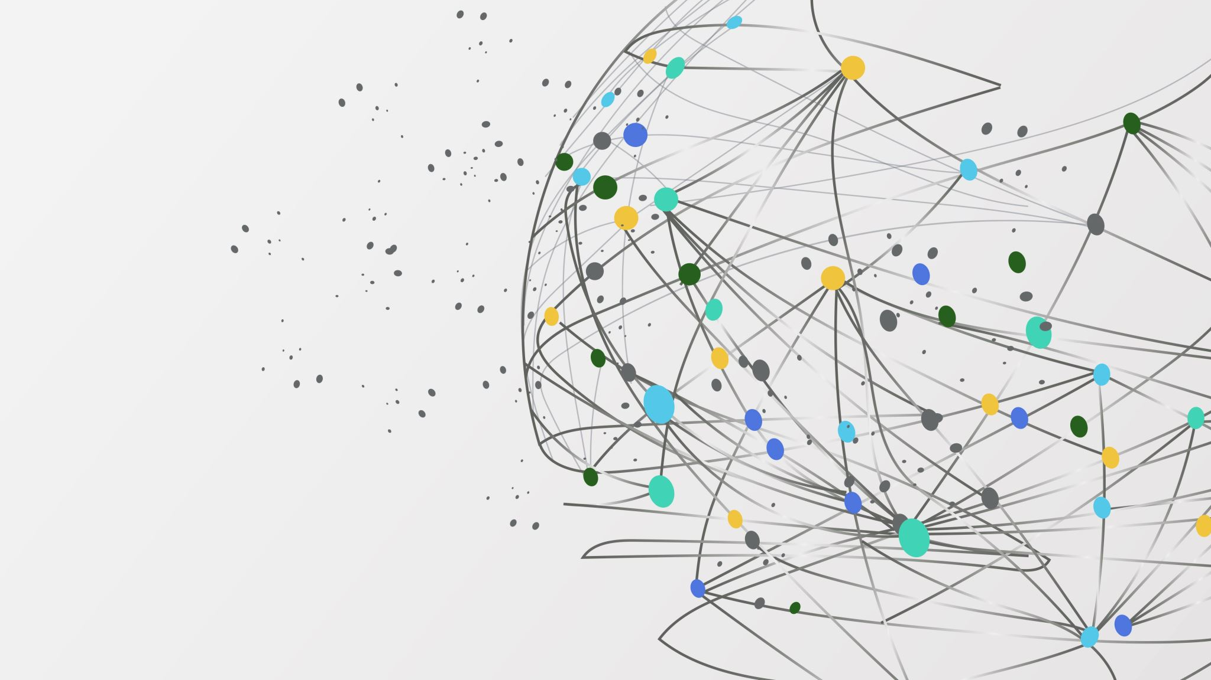
PROJECT GameCo
Tomislav Radić

Slide 2

Introduction
Our current understanding, expectations and strategy
Goals
Analysis
Global Market
Regional Markets
Summary
Conclusion

Slide 3
This analysis is based on the data set provided by VGChartz. It keeps track of units of games sold (but not financial figures) from 1980 to 2016.
Only games that sold more than 100 000 copies are included
The numbers represent units sold in millions
Please note that because of the incompleteness of the data set and the way the data was collected, this analysis cannot be exhaustive and serves rather to provide some general guidelines.

Slide 4
Our company’s current marketing strategy lies on the assumption that the sales figures for the various geographical regions stayed the same over time.
It is expected that most games are sold in North America, whose market is followed by the European, Japanese and all other markets.

Slide 5

Global Market Analysis

Slide 6
Global Market Overview
Games sales have drastically declined in the last years and that is true for all genres

Slide 7
Global Market Overview

Slide 8
Global Market Overview
The global market is dominated by these ten publishers who together hold 70.12% of all global sales
Top 10 Publishers in World

Slide 9
Global Market Overview
This year, the European market surpassed both North American and Japanese markets for the first time in history
Note how the North American and Japanese markets mirror each other

Slide 10
Global Market Summary
Sales declined globally.
Action, Shooter and Sports remain the most popular genres.
European market currently shows greatest potential as it not only surpassed all other markets in the sales numbers, but it is also the only market that is consistently on the rise.
North American market continues the negative trend.
Japanese market shows signs of recovery in the past two years.
There is a strong negative correlation between the North American and Japanese markets who almost mirror each other i.e., more sales made in one region means less sales in the other. Europe’s market seems relatively unfazed by this competition.

Slide 11
North American Market Analysis

Slide 12
North American Market Overview

Slide 13
North American Market Overview
Top five publishers together hold 53.73% of all North American sales

Slide 14
North American Market Overview

Slide 15
North American Market Summary
North American market continues to drop.
Strong negative correlation to Japan’s market
Shooter is the most popular genre, followed by Action and Sports

Slide 16
European Market Analysis

Slide 17
European Market Overview
Top five publishers together hold 55.71% of all European sales
The top publishers are same in North America and in Europe, and they hold similar shares in both markets

Slide 18
European Market Overview

Slide 19
European Market Overview

Slide 20
European Market Summary
European market surpassed all other markets in 2016
Has a positive trend compared to other regional markets
Same top publishers as in North America
Most popular genre is Shooter, followed by Sports and Action

Slide 21
Japanese Market Analysis

Slide 22
Japanese Market Overview
Top five publishers together hold 63.2% of all sales in Japan
The market is completely dominated by Nintendo who alone holds 35.3% of all sales

Slide 23
Japanese Market Overview

Slide 24
Japanese Market Overview

Slide 25
Japanese Market Summary
Strong negative correlation with North American market
Shows signs of recovery in the past two years
RPG games are much more popular in Japan than in other markets
Popularity of Action games has vastly risen since 2015 and is currently the most popular genre
Market dominated by Nintendo

Slide 26
Analysis Summary

Slide 28
Conclusion
In order to optimize the marketing budget allocation, this data set suggests that a revision in our company's strategy is needed as our initial expectations were wrong. There has been a sizable shift in the global market dynamics, and GameCo is advised to act accordingly – allocate more budget for Europe next year and push the most popular genres in every region:
Europe: Shooter, Sports, Action
North America: Shooter, Action, Sports
Japan: Action and RPG

Slide 29
Thank you

